Slide 1


SENTIMENT ANALYSIS
USING R
Jailani Shajith
3rd Year
B.Tech CSBS

Slide 2

ABSTRACT
This project explores sentiments and perceptions of life within a college community, focusing on attitudes of peers and staff. A custom dataset was created from a Google Form survey, gathering reflections on life, which was then imported into R for analysis. The methodology included data preprocessing steps like tokenization, stopword removal, and punctuation elimination to prepare the text for sentiment analysis. Using R's Sentiment library, tokens were classified as positive, negative, or neutral, allowing for a clear view of sentiment distribution. Visualizations, including a WordCloud for prominent sentiments and a pie chart showing the overall sentiment breakdown, provided an accessible summary of perceptions within the community.

Slide 3
DATA COLLECTION & STORAGE
Survey Design:
Sample Population:
The survey was shared across college channels, targeting a diverse group within the community.
Responses were collected from various departments to ensure a representative sample.
A Google Form survey was created to capture personal reflections and opinions about life from members of the college community, including students and staff.
Question Structure:
Data Storage:
The survey included open-ended questions to encourage participants to express their thoughts and emotions in their own words.
Questions focused on capturing a broad range of sentiments, from positive and motivational thoughts to challenges and uncertainties.
Responses were saved automatically in Google Sheets, then exported as a CSV file.
This CSV file served as the primary dataset for the sentiment analysis, allowing for seamless importation and manipulation within R for further processing and analysis.
window.__oai_logHTML?window.__oai_logHTML():window.__oai_SSR_HTML=window.__oai_SSR_HTML||Date.now();requestAnimationFrame((function(){window.__oai_logTTI?window.__oai_logTTI():window.__oai_SSR_TTI=window.__oai_SSR_TTI||Date.now()}))

Slide 4
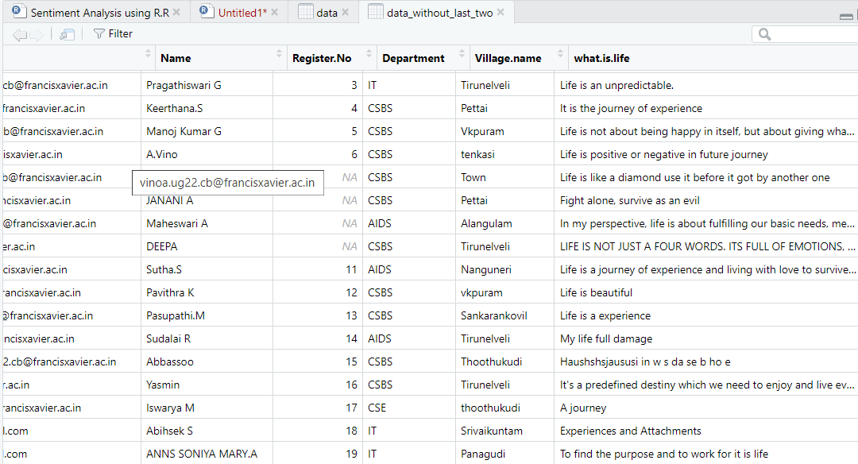
DATASET

Slide 5

DATA PREPROCESSING
After collecting responses, the data was exported to a CSV file and imported into the R environment for analysis. Initial exploratory data analysis provided insights into the dataset's structure and content. The following preprocessing steps were implemented to prepare the textual data for sentiment analysis:
Tokenization: Text was broken down into individual tokens or words to facilitate analysis.
Removing Stopwords: Common stopwords (e.g., "the," "is," "and") were removed as they do not contribute meaningful insights.
Removing Punctuation: Punctuation marks were eliminated to focus solely on significant words, ensuring cleaner data for sentiment analysis.

Slide 6
SENTIMENT ANALYSIS
Sentiment Scoring:
Using the Sentiment library in R, sentiment scores were calculated for each token in the dataset. These scores helped categorize words as positive, negative, or neutral based on their sentiment polarity.
Classification of Words:
Positive Words: Words that convey optimism or favorable emotions (e.g., "happy," "success").
Negative Words: Words reflecting challenges or unfavorable emotions (e.g., "sad," "failure").
Neutral Words: Words with no strong emotional association.
Sentiment Insights:
This classification provided a clear understanding of the prevailing sentiments toward life, highlighting trends in positive and negative perceptions.

Slide 7
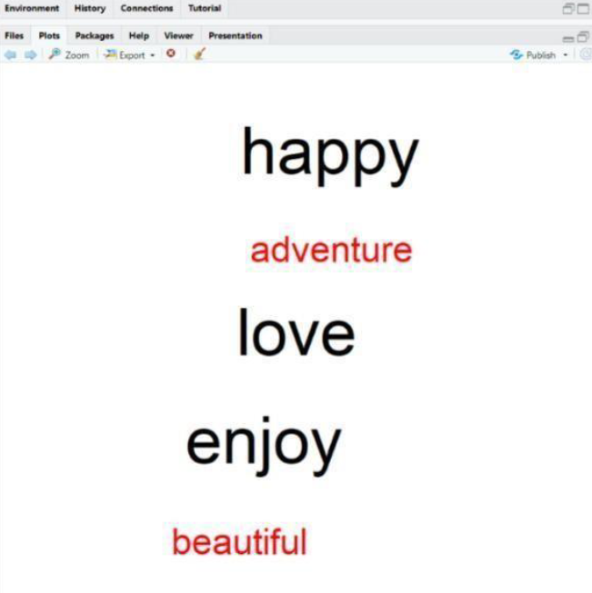
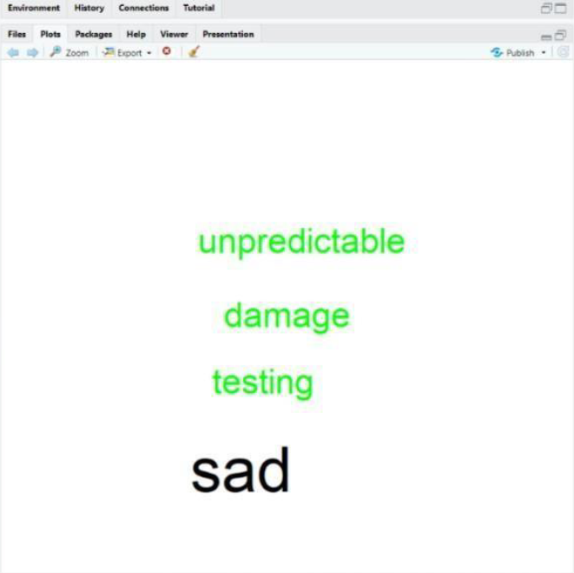
POSITIVE WORDS
NEGATIVE WORDS

Slide 8
RESULT
The sentiment analysis revealed a diverse range of perceptions and attitudes towards life within the college community. While there were instances of both positive and negative sentiments, the predominant sentiment leaned towards positivity. The WordClouds highlighted the most frequently occurring positive and negative words associated with life, offering insights into the prevailing sentiments. The pie charts provided a visual representation of the distribution of sentiments, facilitating a comprehensive understanding of the overall sentiment landscape.

Slide 9
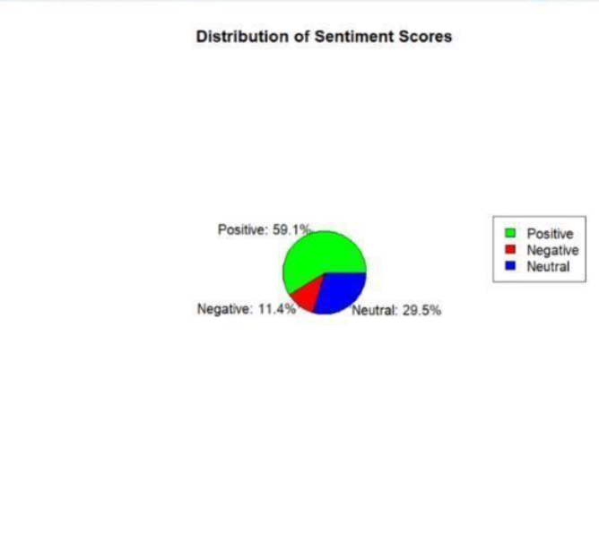
FINAL OUTPUT
The sentiment analysis of the data suggests that the overall perception
of life within the college community is positive.

Slide 10

CONCLUSION
In conclusion, this project provided valuable insights into the perceptions and sentiments surrounding life within the college community. By leveraging sentiment analysis techniques, we gained a deeper understanding of the prevailing attitudes and opinions towards life among peers and staff members. The findings suggest a predominantly positive outlook on life within the college community, characterized by optimism and hope. However, it is essential to acknowledge the presence of diverse perspectives and experiences, contributing to a rich tapestry of human emotions and attitudes. The results of this analysis enrich our understanding of the diverse perspectives within the college environment and contribute to a broader discourse on human experiences and emotions.

Slide 11
THANK YOU
Sentiment Analysis Presentation

